Slide 1


Diagnosis Validation Engine
INNOVATORS 123
Challenge – [AI and ML]
the Frontier of ADVANCED TECHNOLOGY IN Health Care

Slide 2
Team Member Profiles
Pic
Pic
Pic
Prachi Singhal
OGS Tech, Gurgaon, Software Engineer
Nikhil Tyagi
OGS Tech, Gurgaon, Assoc Software Engineer 2
Bhaskaran
OGS Tech, Gurgaon, Mgr Sofware Engineering
Title
Title
Title
Pic
Pic
LakshmiHanisha
OGS Tech, Gurgaon, Assoc Software Engineer 2
Manas Palwar
Division, Location, Product Analyst
Title
Title

Slide 3
Problem Overview
MEDICAL MISDIAGNOSIS happens when the patient’s actual diagnosis is missed or confused for something else. Medical misdiagnosis is an underdiscussed and complex issue to address. It is on the rise despite the presence of latest technologies like symptom checkers, predictive diagnosis.
ROOT CAUSES
Cognitive Biases: 80% of misdiagnoses happen because of cognitive biases.
Anchoring bias: Physicians focus on the first diagnosis that comes to their mind based on primary symptom.
Availability bias: Physicians see too many of the same symptom disease pair in their work and are pulled towards the same diagnosis when they see similar symptoms.
Technical or Systemic Issues cause 15% misdiagnoses every year
Faulty lab equipment used for diagnostic tests
Incorrect medical history
Incorrect interpretation of lab results
12 million people are affected by medical diagnostic errors each year.
Estimated 40,000 to 80,000 people die annually from complications from these misdiagnoses.
Diagnostic errors contribute to 10% of patient deaths and 6-17% of hospital adverse events
Misdiagnosis has the greatest financial impact out of all medical errors
Notes:
https://www.pinnaclecare.com/forms/download/Human-Cost-Financial-Impact-Whitepaper.pdf

Slide 4
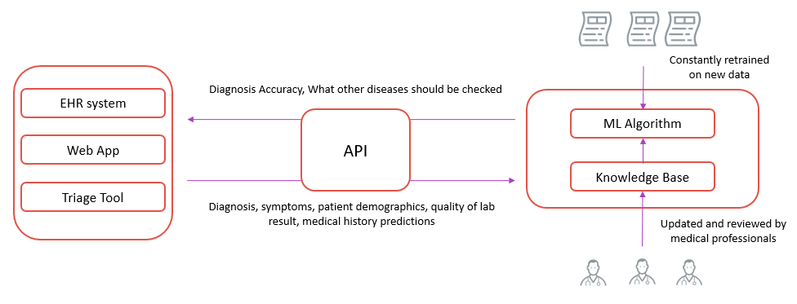
Solution Model
Solution Overview: A web application that the physician can use to prevent cognitive biases from hindering the physician’s diagnosis capability. The solution includes the following components:
A web app that allows the physician to enter the patient’s symptoms and the diagnosis the physician has derived.
A machine learning algorithm that is trained with millions of records of comprehensive diagnosis data which enables it to predict the probability of the diagnosis made by the physician and what other diagnoses the physician should check.
Inputs to Machine Learning Model
Use Patient Medical records to get
Diagnosis made by physician
Symptoms and each symptom’s duration
Patient interview duration
Patient demographics
How strongly the lab results supported the diagnosis
Whether the diagnosis was correct or not
Whether the diagnosis supported by patient’s medical history
Output
Probability of Misdiagnosis
What other diagnoses physician should consider
Short Description of How Your Solution Works – [AI and ML, NLP, AR and VR, IoT, Genomics, Graph, Cognitive, Quantum and Parallel Compute]

Slide 5
Solution Synopsis, Demonstration
Machine learning program that can be integrated with web app, ehr, websites
Attacks the cognitive biases that are involved in 80% of medical misdiagnoses cases using comprehensive diagnosis data
using machine learning to predict misdiagnosis based on physicians’ diagnostic error patterns
Step1: create a data repository of diagnoses, accuracy of diagnoses, reason for diagnosis, patient interview duration, impact of quality of lab result
Step2: train an ml model diagnosis accuracy
step3: provide actionable output to physician
What value is delivered by your solution?
Will reduce rate of misdiagnosis without altering the differential diagnosis process used by physicians.
Increase patient trust and avoid avoidable deaths
IP Disclosure (Optional):
http://goto.uhg.com/patents (click on “Create Disclosure” button)

